Slide 1
Wheresoever you go, go with all your heart.
– Confucius
Lecture 21 – Decrease-by-a-Constant-Factor Algorithms
CST370 – Design & Analysis of Algorithms
Dr. Byun
Computer Science

Slide 2
Lecture Objectives
After completion of this lecture, you will be able to
  perform a decrease-by-a-constant-factor algorithm that reduces the size of a problem by a constant percentage.

Slide 3
Chapter 4: Decrease-and-Conquer
4.1 Insertion Sort
4.2 Topological Sorting
4.3 Algorithms for Generating Combinatorial Objects
4.4 Decrease-by-a-Constant-Factor Algorithms
4.5 Variable-Size-Decrease Algorithms

Slide 4
Decrease by a constant factor
It is one of the decrease-and-conquer techniques.
  Typically, we reduce the size of a problem by half (= 50%).

Slide 5
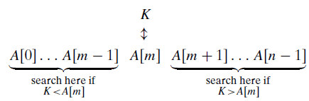
Example – Binary Search
Binary search is a very efficient algorithm for searching in a sorted array.
  The key point of the algorithm is that the number of elements in a list is reduced by half each time.

Slide 6
Analysis of Binary Search
Best case:
Worst case:

Slide 7
Resource
To review the binary search algorithm, see the video https://goo.gl/KrX5jD

Slide 8
Question
Can you do the searching in O(log n) with a sorted singly linked list?

Slide 9
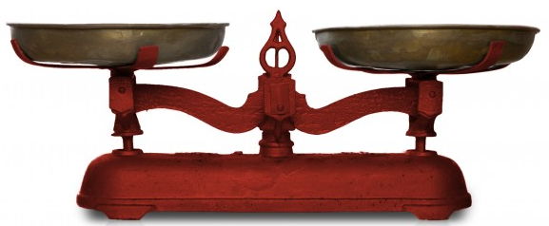
Fake-Coin Problem (1 of 2)
Suppose you have n coins with one fake coin that is lighter than the rest of coins.
  How can you find the fake coin using a balance scale below?
  Note: You must consider both odd and even numbers.

Slide 10
Fake-Coin Problem (2 of 2)
If n is an even number, you can divide the coins into two piles of size n/2.
  Weigh the two piles and exclude the heavy pile (= 50% reduction).
  Continue the measurement with another pile.
If n is an odd number, set aside one coin and divide the remaining (n-1) coins into two piles.
  If the two piles are equal, the coin set aside is the fake coin.
  Otherwise, we exclude the heavy pile and continue the measurement with another pile.

Slide 11
Russian Peasant Multiplication

Slide 12
Exercise

Slide 13
Puzzle (1 of 2)
Suppose there's a stack of 10 coins like below.
  Note that the bottom coin is gold and the rest are all ordinary coins.

Slide 14
Puzzle (2 of 2)
There are two players in the game.
  They take turns by removing coin(s) from the top.
  Each player can remove up to four coins from one coin.
  The winner of the game is the player who takes the last coin.
  Who will win the game between the first removing player and the second removing player?
  Of course, both players will do their best to win.

Slide 15
Solution

